Slide 1


Application of a Machine Learning Algorithm,Self-Organizing Map, for Examining the consistency between reanalyses about near-surface horizontal wind fields
Shun Li

Slide 2
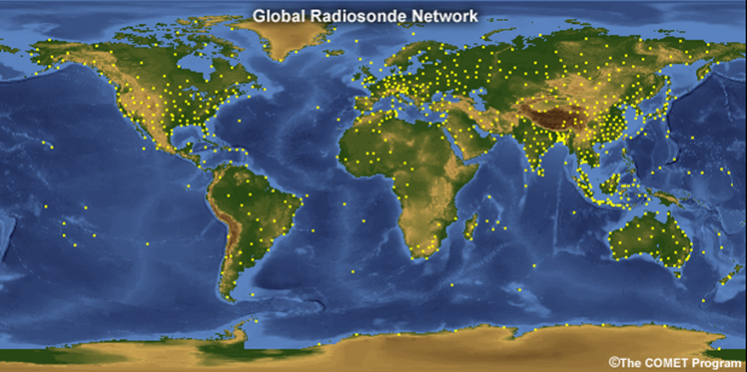
Motivation
What is Atmosphere reanalysis ?
Atmosphere reanalysis provide the best estimate of the atmospheric state at any one time, usually by combining in-situ and satellite observations with forecast model data from a fixed version of a numerical weather prediction (NWP) system.
Atmosphere reanalysis = forecast model + satellite observations
Models carry biases and errors in simulating and forecasting atmosphere state
Large biases and errors also exit in all observational data, including temporal and spatial coverage

Slide 3
Presentation Outline
This talk describes a scheme based on pattern matching of characteristic wind patterns derived using machine learning algorithms.
This analysis is used to examine the consistency of surface winds in two reanalyses products over different regions and different years.
Goal:
---- Which regions the quality of consistency for different atmospheric reanalyses is
best、worst or others?
--- Which years the quality of consistency for different atmospheric reanalyses is
best、worst or others?
--- How these atmospheric reanalyses characterize the atmospheric state in
Antarctic regions, is it bad? And if so, how bad?

Slide 4
Data Acquisition
Three centres took initiative in mid 1990s: first generation
– ERA-15 (1979 - 1993) from ECMWF – with significant funding from USA
– NASA/DAO (1980 - 1993) from USA
– NCEP/NCAR (1948 - present) from USA
• Second generation of reanalyses followed
– ERA-40 (1958 - 2001) from ECMWF – with significant funding from EU FP5
– JRA-25 (1979 - 2004) from Japan
– NCEP/DOE (1979 - present) from USA
• Now in third generation of comprehensive global reanalysis
– ERA-Interim (1979 - present) from ECMWF
– JRA-55 (1958 - 2012) from Japan
– NASA/GMAO-MERRA (1979 - present) from USA
– NCEP-CFSRR (1979 - 2008) from USA
– ERA20C(1900-2010) from ECMWF
European Centre for Medium-Range Weather Forecasts

Slide 5
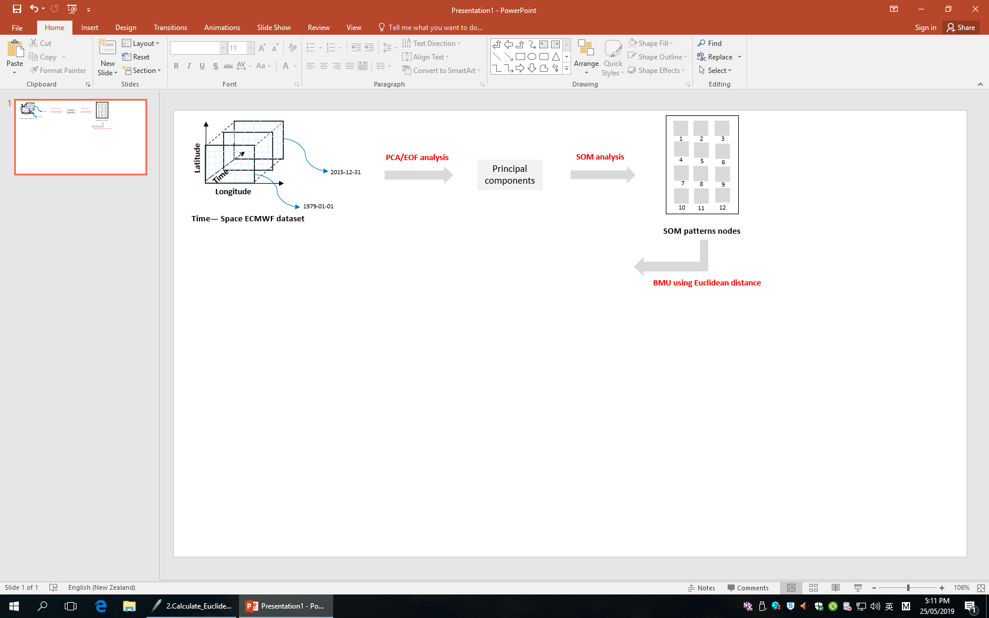
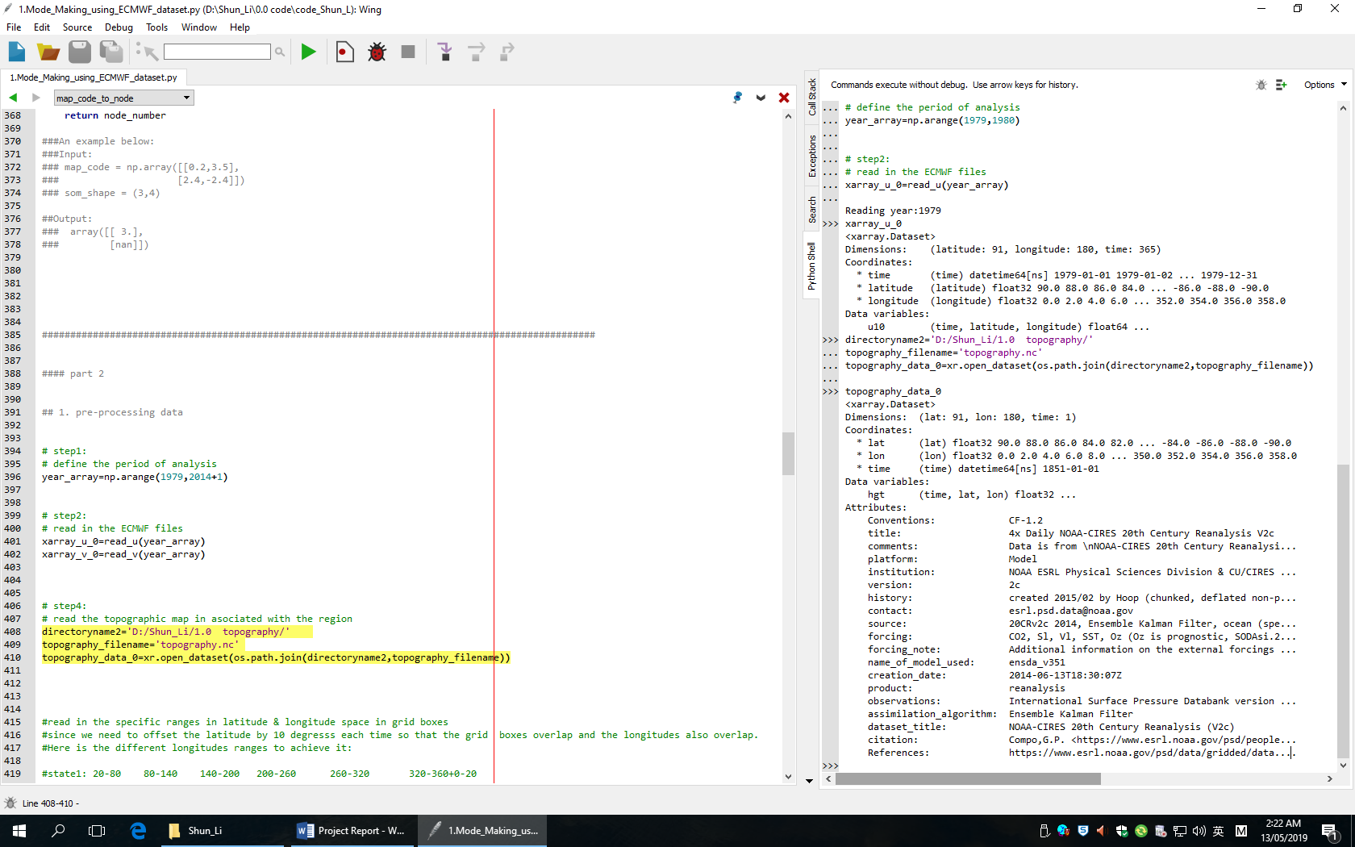
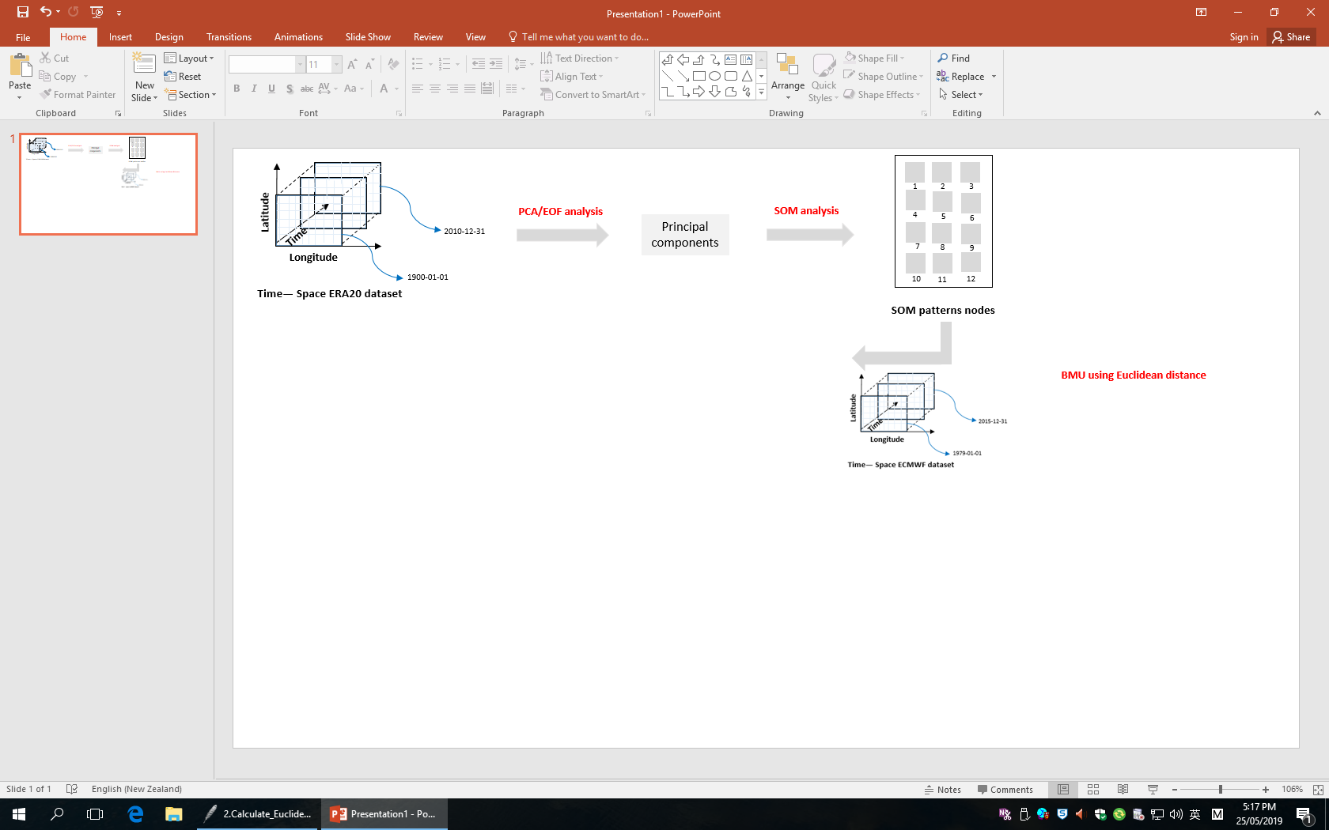
Data format :netCDF
Computer Language: python
Libraries:
numpy
pandas
xarray
netCDF4
matplotlib
cartopy
sompak
.
.
.
topography data in python xarray open

Slide 6
Data Cleaning and Re-processing
EOF / PCA:
Empirical Orthogonal Function technique(EOF),also referred as eigenvector Analysis, or principal component analysis(PCA).
It is a method to analyze the structure feature of matrix data and extract the main data feature
space
time

Slide 7
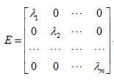
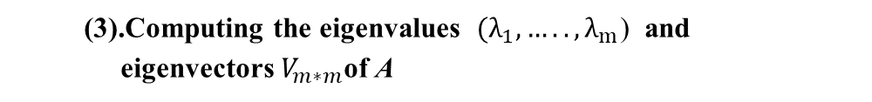
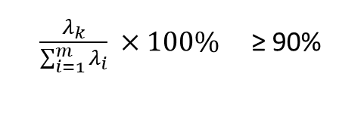
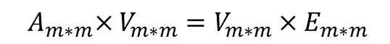
(1).Selecting the data, and preprocessing data to obtain the data matrix
(4).Arranging the eigenvalues from the largest ones to the smallest
ones.
(2).Computing the cross product of X with its transpose
(5).Computing principal components Z.
(3).Computing the eigenvalues $(λ_{1},…..,λ_{m}$) and
eigenvectors $V_{m∗m}$of A
(6).Computing contribution rate and removing noisy that covers less important information.
$${ A}_{m∗m}×V_{m∗m}=V_{m∗m}×E_{m∗m}$$
$\frac{λ_{k}}{\sum_{i=1}^{m}{λ_{i}}} ×100\%$ ≥ 90%

Slide 8
Data Modeling
Self-Organizing-Map:
a type of artificial neural network that is trained using unsupervised learning to produce a low-dimensional(typically two-dimensional),discretized representation of the input training samples.
Supervised Learning | Artificial Neural Network | Used for Regression & Classification
 | Convolutional Neural Networks | Used for Computer Vision
 | Recurrent Neural Networks | Used for Time Series Analysis
 | Support Vector Machines | Used for Regression & Classification
Unsupervised Learning | Self-Organizing Maps | Used for pattern Detection
 | K-means clustering | Used for cluster analysis
 | Deep Boltzmann Machines | Used for Recommendation Systems

Slide 9
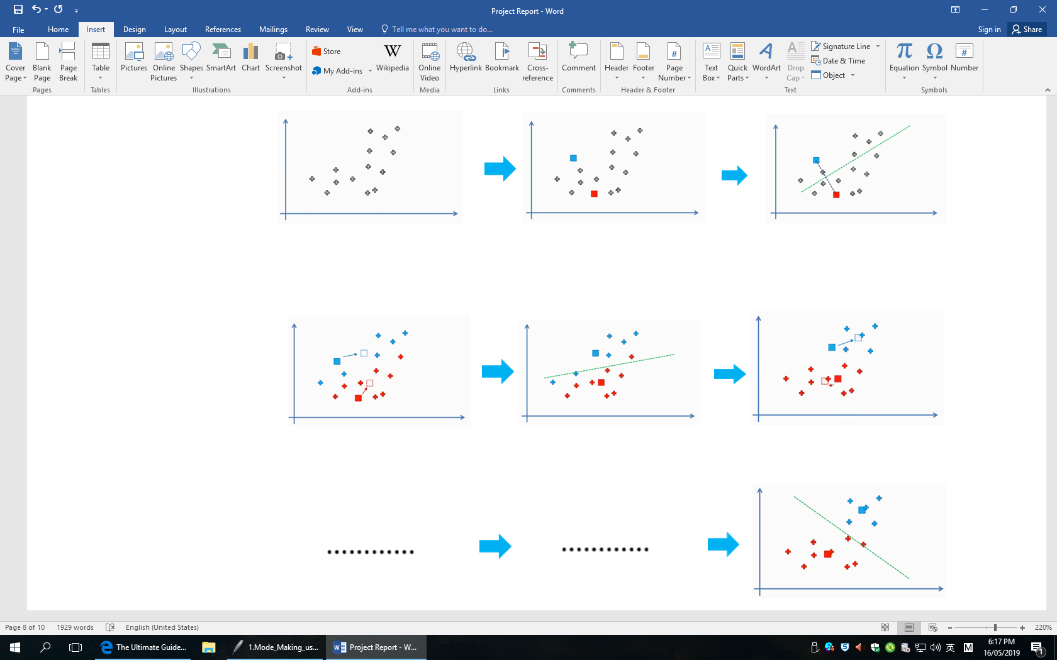
K-means clustering

Slide 10
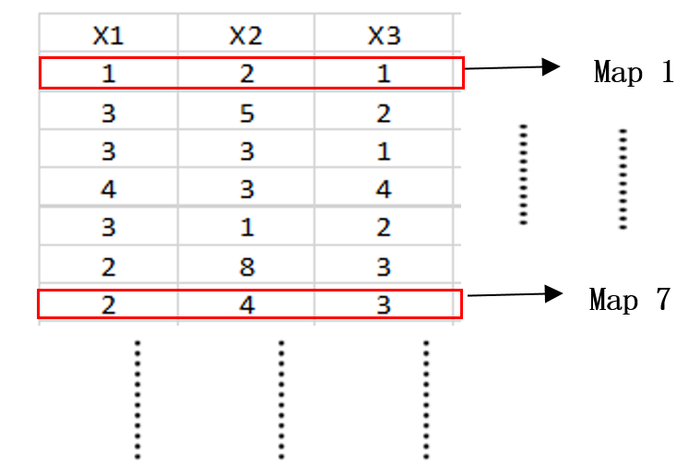
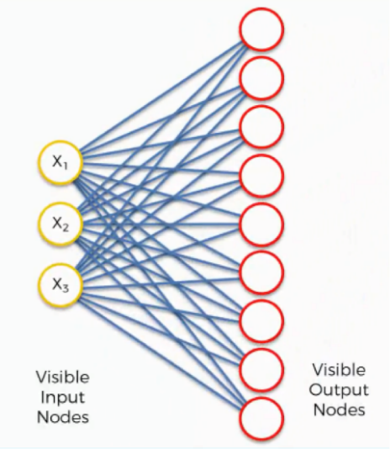
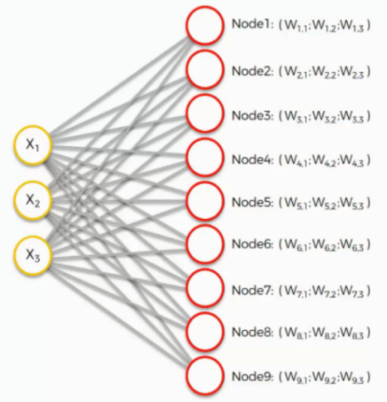
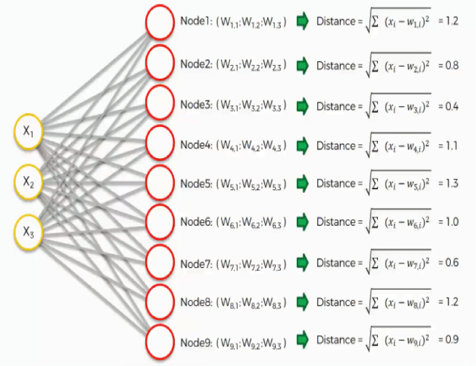
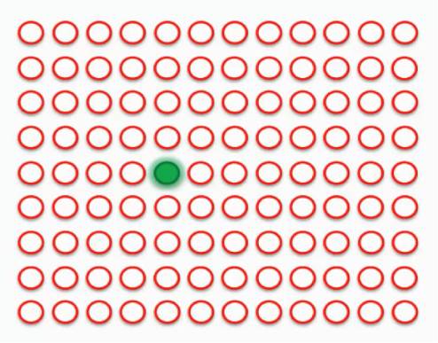
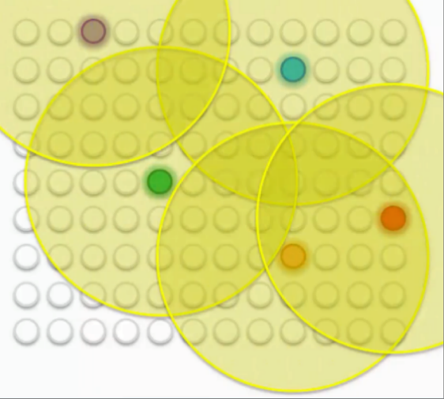
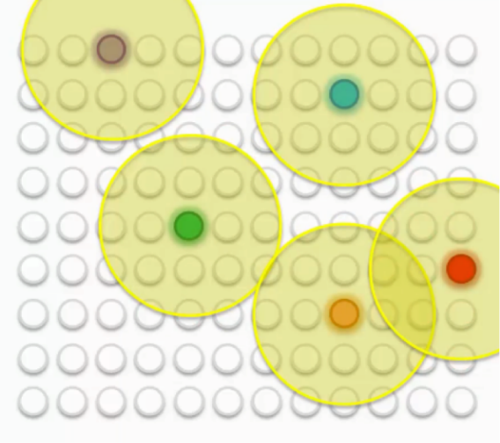
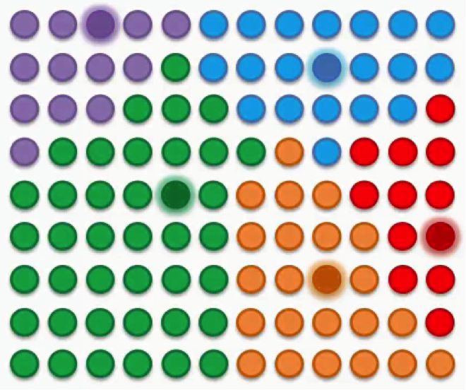
SOM algorithm:

Slide 11
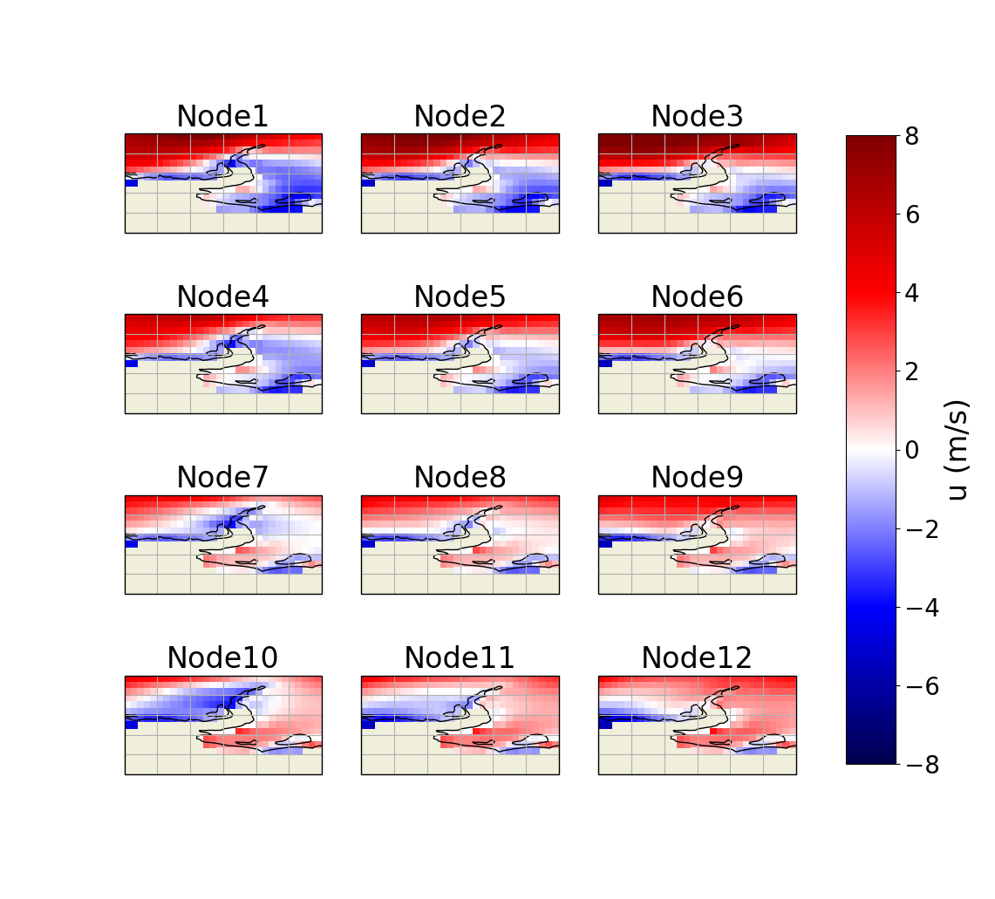
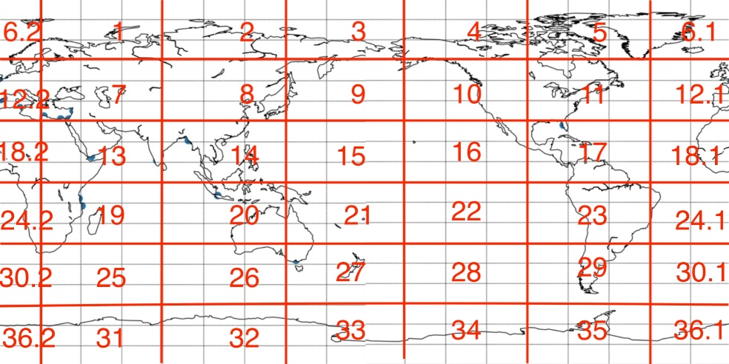
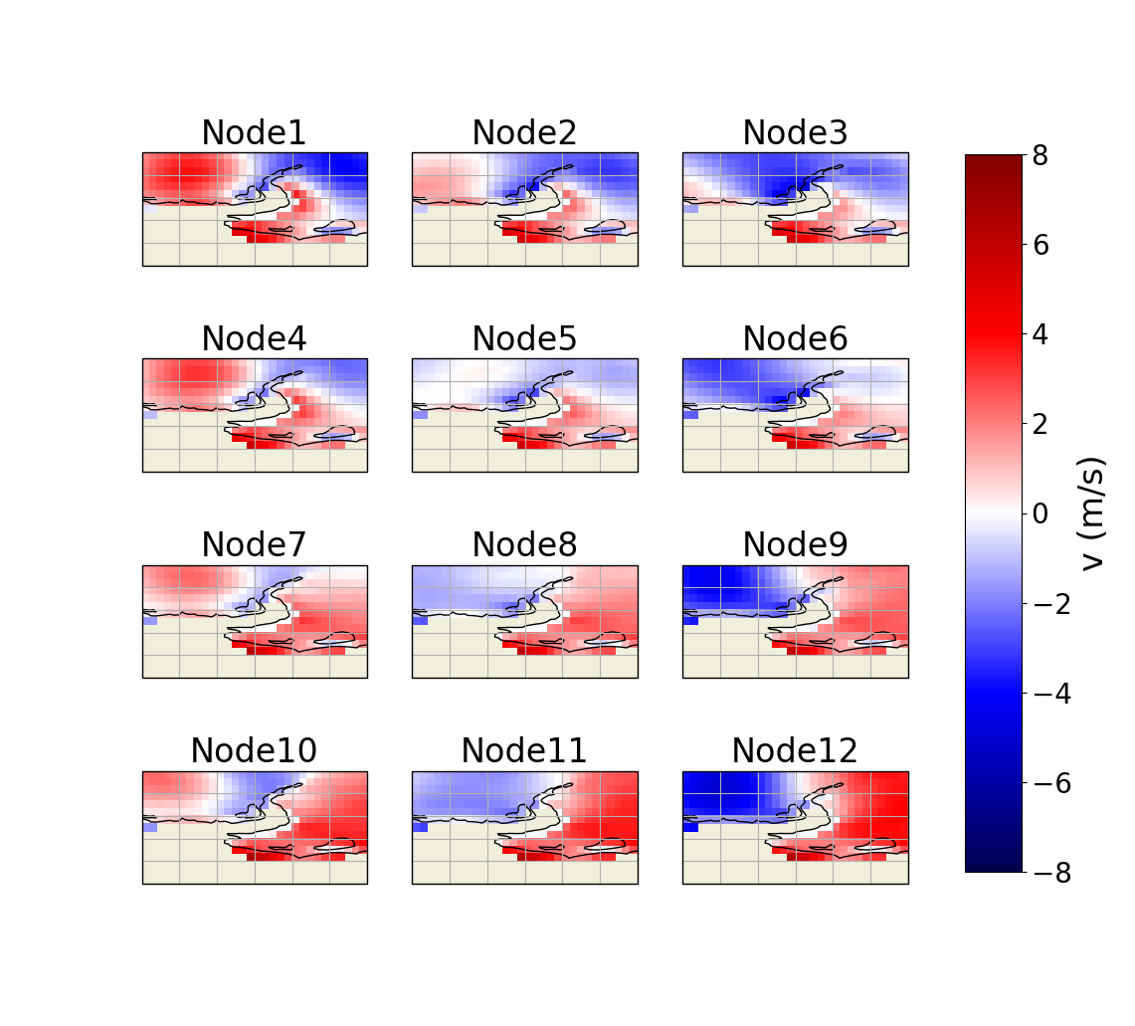

Slide 12
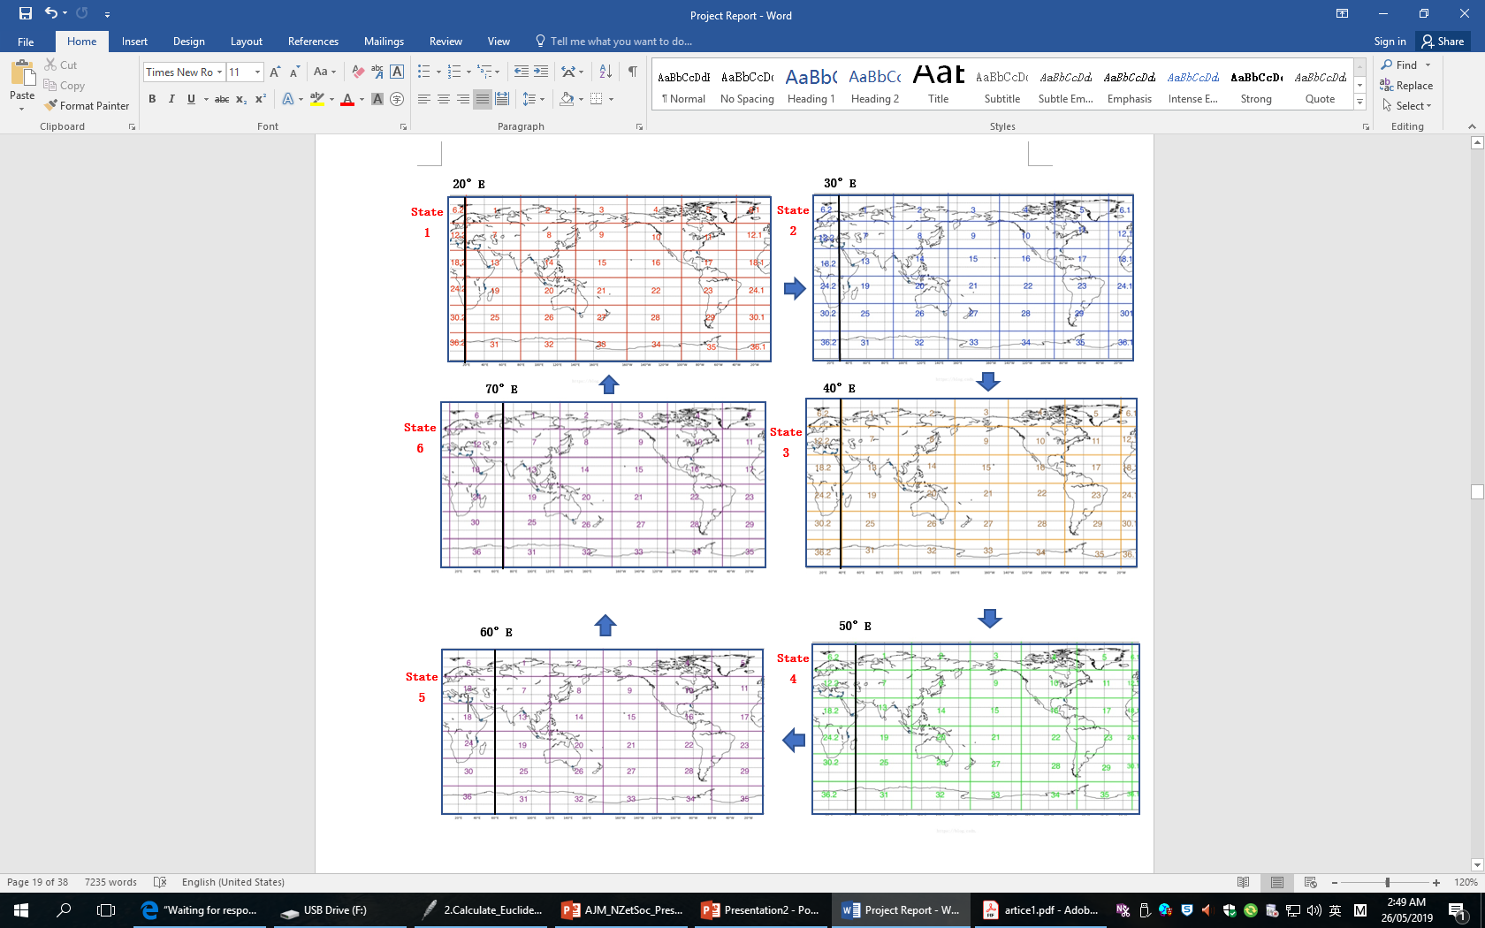
Model adjustment

Slide 13
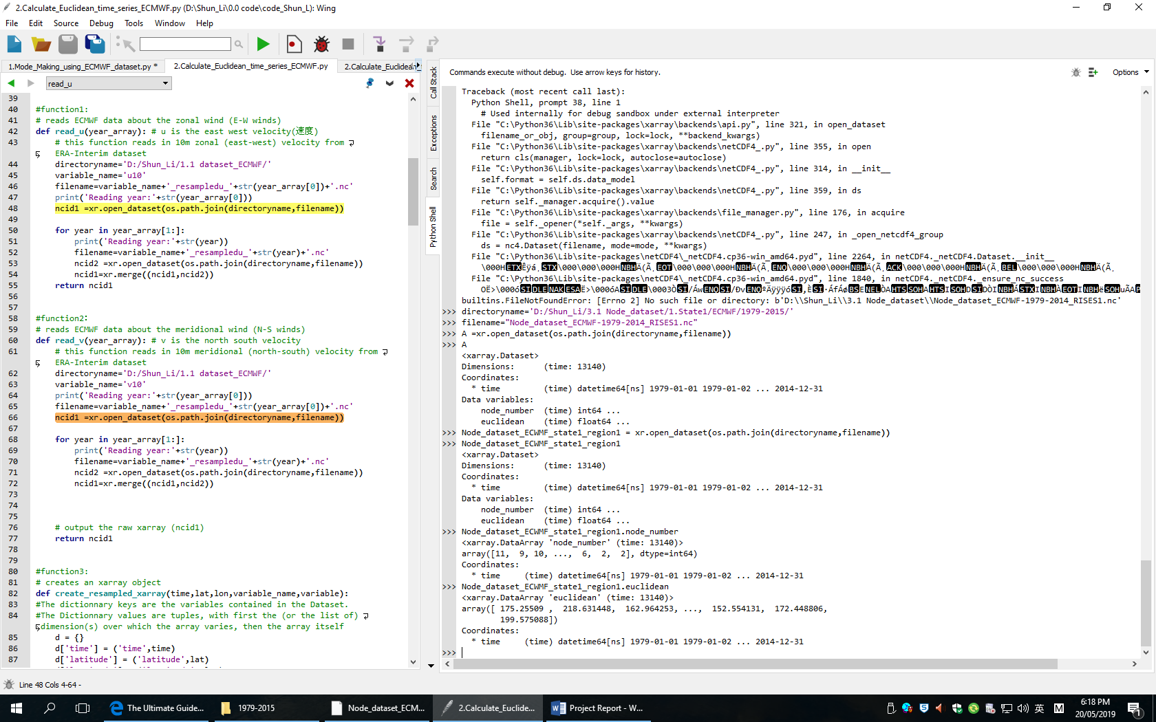
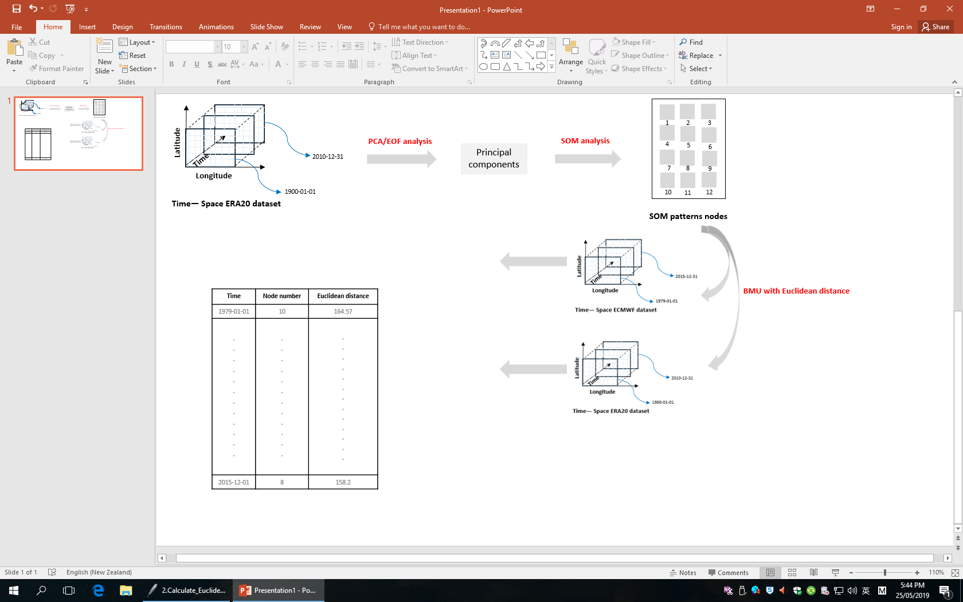
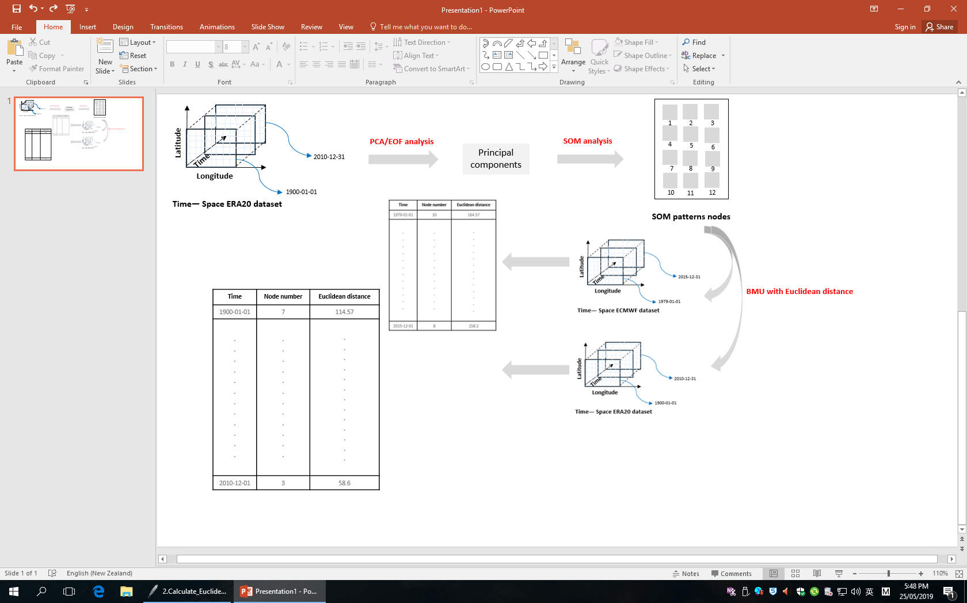
Evaluation
Histogram
Node dataset for ECMWF about region1, state1 in python xarray open
Node dataset ECMWF
Node dataset ERA20C

Slide 14
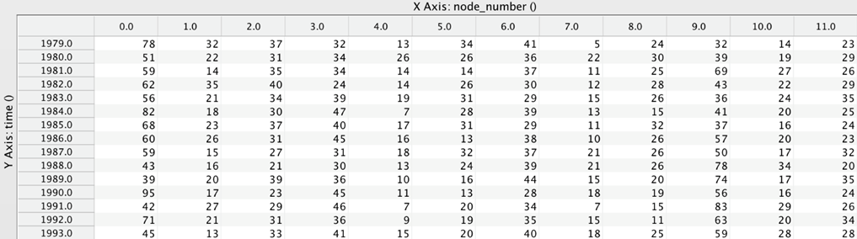
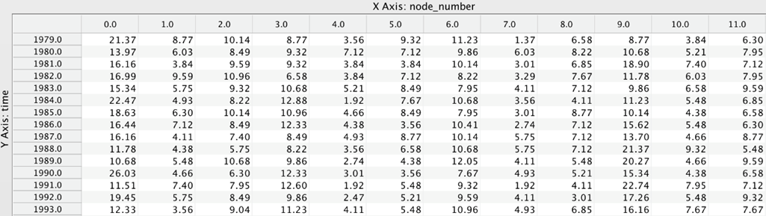
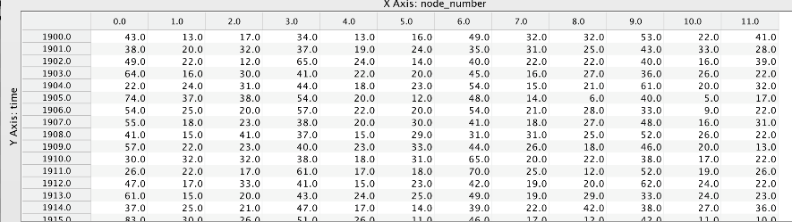
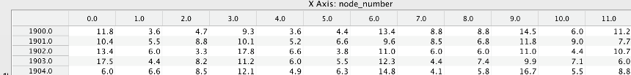
Histogram of Frequency of occurrence,ECMWF
Histogram of Relative Frequency of occurrence,ECMWF
Histogram of Frequency of occurrence,ERA20C
Histogram of Relative Frequency of occurrence,ERA20C

Slide 15
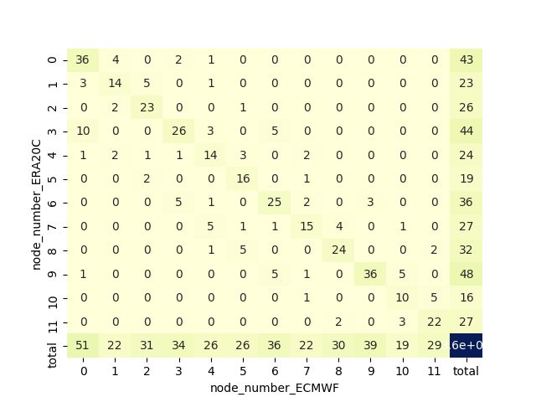
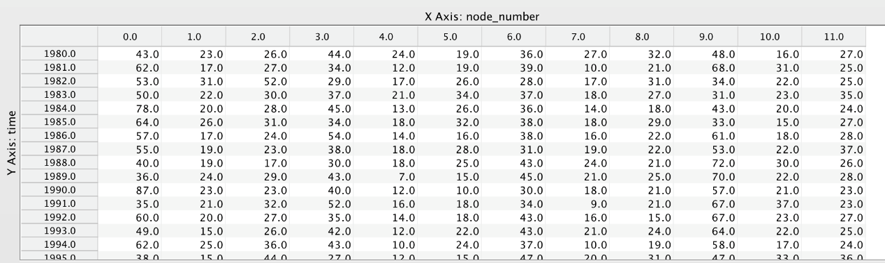
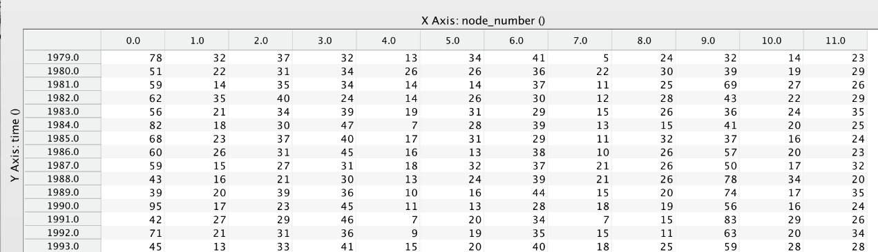
Contingency Table
contingency table about region1, state1 in 1980

Slide 16
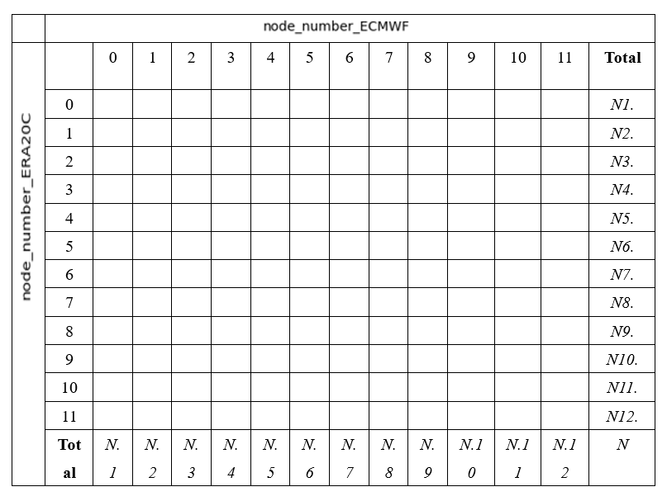
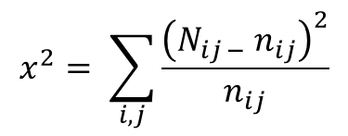
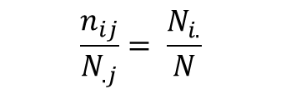
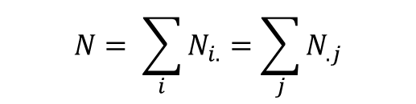
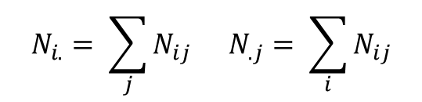
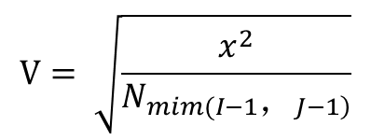
Chi-Square
$$N_{i.}= \sum_{j}{N_{ij }}N_{.j}= \sum_{i}{N_{ij}}$$
$$N= \sum_{i}{N_{i.}}=\sum_{j}{N_{.j}}$$
$$\frac{n_{ij}}{N_{.j}}= \frac{N_{i.}}{N}$$
Cramer’s V :
$$x^{2}= \sum_{i,j}{\frac{{\left(N_{ij −} n_{ij}\right)}^{2}}{n_{ij}}}$$
$$V= \sqrt{\frac{x^{2}}{N_{\left.mim(I−1，J−1\right)}}}$$

Slide 17

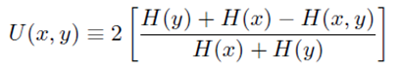
Entropy
Father of Information theory
: Claude Shannon
Dependency :

Slide 18
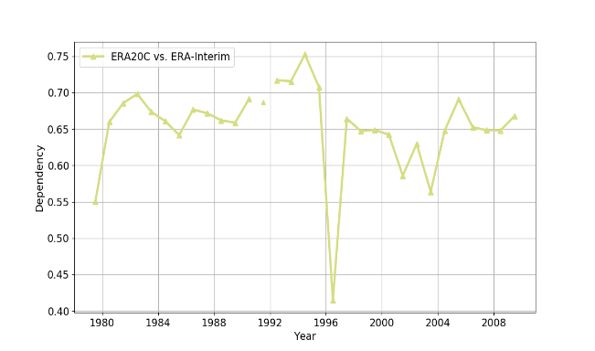
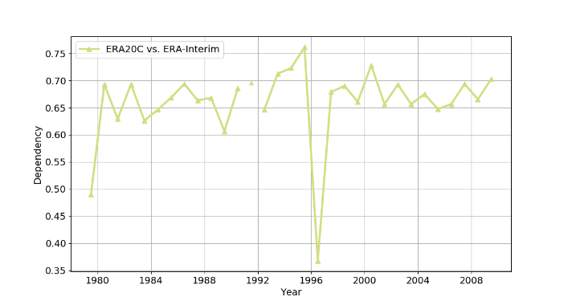
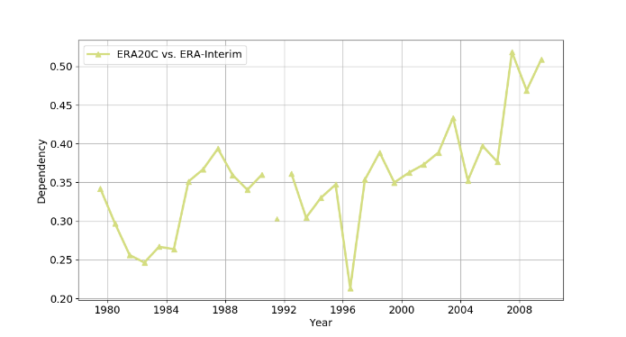
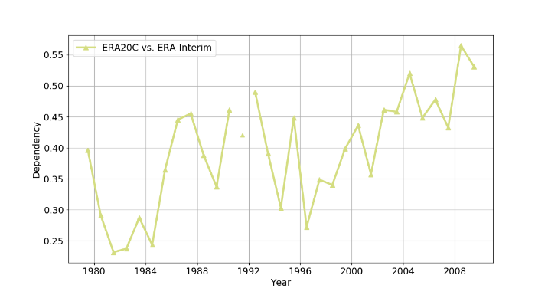
Results
Association plot with regions
.
.
.
.
.
.
.
.
.
.
.
.
time series of Dependency in region1,state1
time series of Dependency in region6,state1
.
.
.
.
.
.
.
.
.
.
.
.
.
.
.
.
.
.
time series of Dependency in region31,state1
time series of Dependency in region36,state1

Slide 19
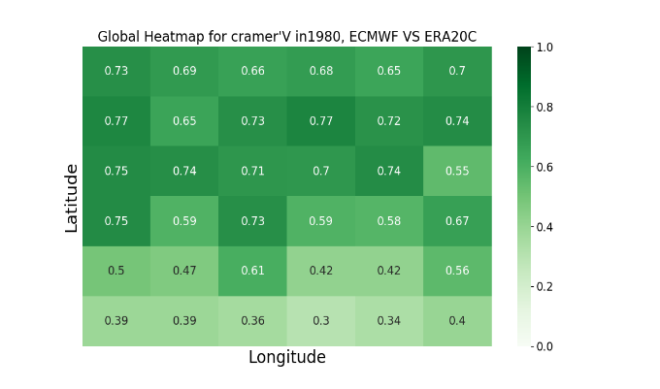
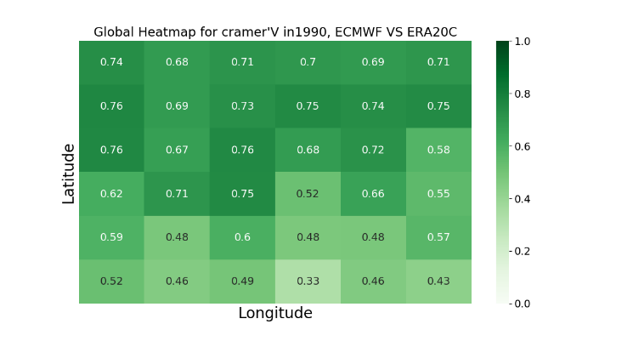
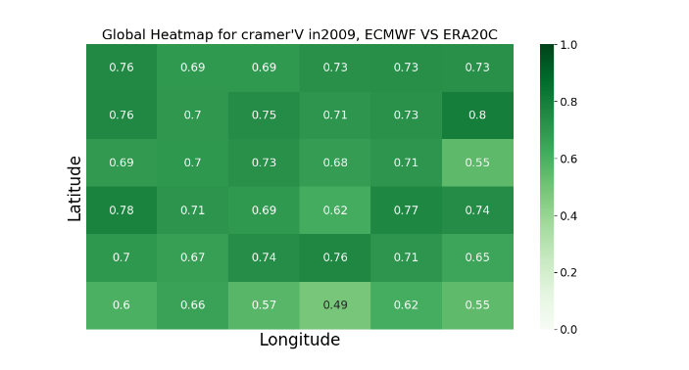
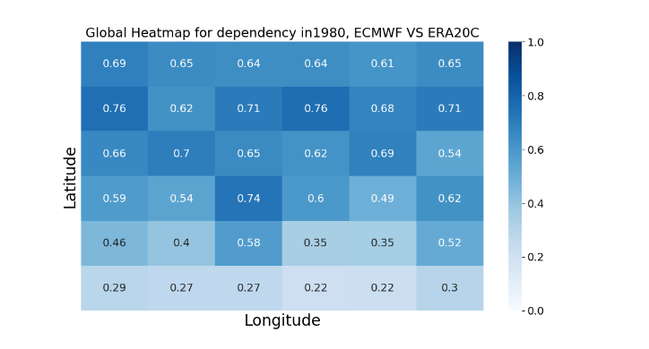
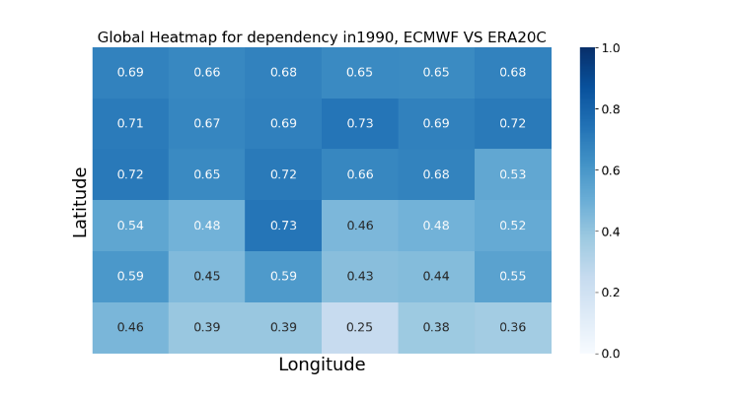
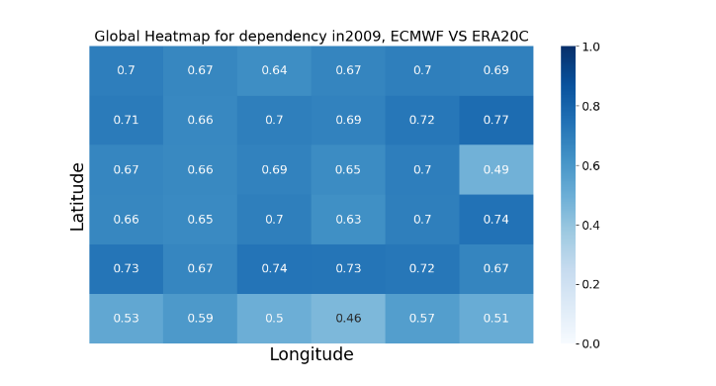
Association plot with time
.
.
.
.
.
.
.
.
.
.
Heatmap for cramer’v in 1980 in state1
Heatmap for cramer’v in 1990 in state1
Heatmap for cramer’v in 2009 in state1
.
.
.
.
.
.
.
.
.
.
Heatmap for dependency in 1980 in state1
Heatmap for dependency in 1990 in state1
Heatmap for dependency in 2009 in state1

Slide 20
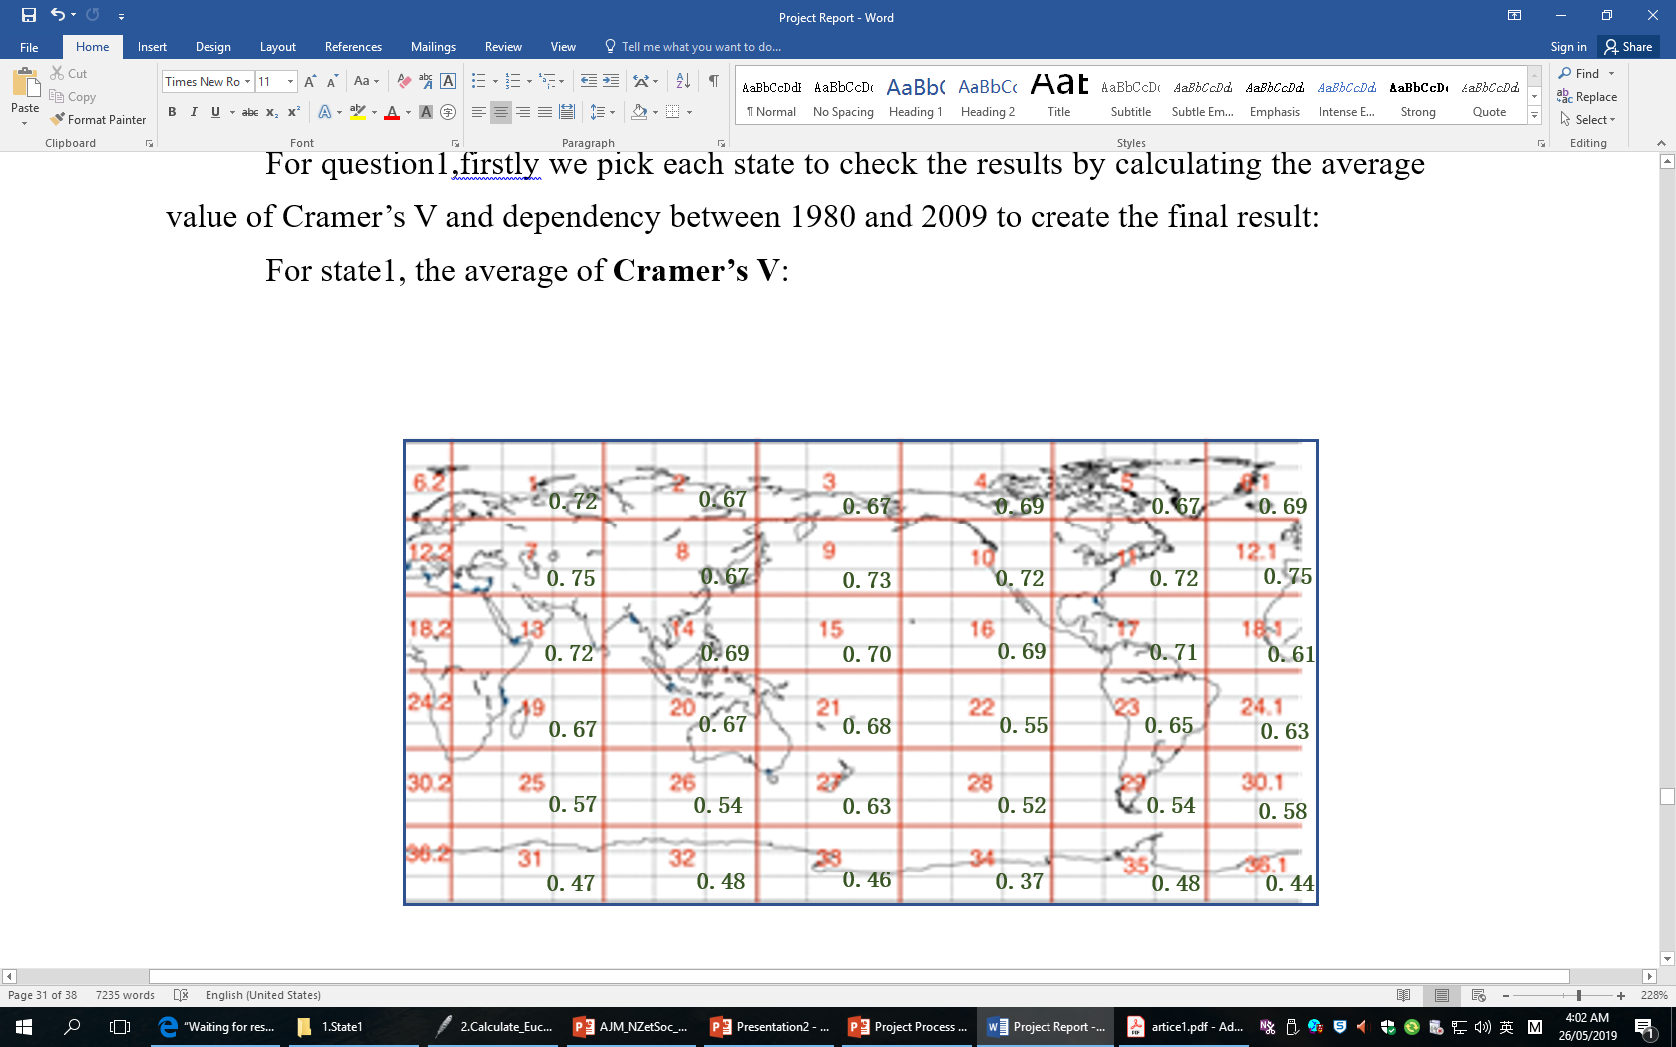
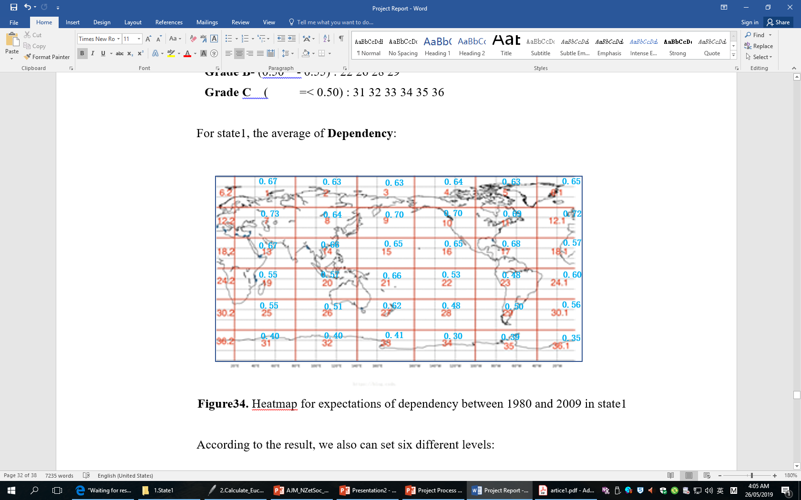


Conclusions
- Which regions the quality of consistency for different atmospheric reanalyses is best、worst or others?
Heatmap for expectations of Cramer’s V between 1980 and 2009 in state1
Heatmap for expectations of Dependency between 1980 and 2009 in state1

Slide 21





- Which years the quality of consistency for different atmospheric reanalyses is best、worst or others?
Time Series of Cramer’s V between ERA20C and ECMWF (Grade A+)
Time Series of Cramer’s V between ERA20C and ECMWF(Grade B+ & Grade B)
Time Series of Cramer’s V between ERA20C and ECMWF(Grade C)
Time Series of Cramer’s V between ERA20C and ECMWF(Grade B-)
Time Series of Cramer’s V between ERA20C and ECMWF (Grade A)

Slide 22
- How these atmospheric reanalyses characterize the atmospheric state in Antarctic regions, is it bad? And if so, how bad?
Based on the figures and charts in question1 ad question2,we can determine the fact that the atmospheric reanalyses indeed characterize worst in Antarctic regions. Almost all the region blocks are graded with C, which is lowest ones; and the range of changes about Cramer’s V in these regions also are larger than other regions.

Slide 23
! Thank You !
one interesting video about information entropy:
https://www.youtube.com/watch?v=2s3aJfRr9gE&t=355s

